Slide 1

Business Revenue & Profit Analysis Dashboard
By Durga Bhavani

Slide 2

Project Overview
Aim: Analyze sales, discounts, expenses, and profits by department.
Purpose: Identify cost efficiency and growth opportunities.
Tool Used: MS Excel (Pivot Tables, Charts, KPIs, Slicers).
Data Type: Sample company financial dataset.

Slide 3
Project Methodology
1. Data Exploration
Imported the raw dataset and examined its structure, field types, and data quality.
Researched and interpreted the meaning of each field to understand business context.
Identified missing values, blank entries, and inconsistencies in records.
2. Data Cleaning & Transformation
Handled missing and blank values using suitable cleaning techniques.
Added calculated fields required for deeper analysis and KPI computation.
Ensured data consistency, accuracy, and readiness for analysis.
3. Data Analysis & Visualization
Utilized Pivot Tables, filters, and Excel formulas to calculate key performance metrics.
Developed KPI cards, charts, and summary tables for clear data interpretation.
Highlighted insights and patterns supporting business decision-making.

Slide 4
Data Overview
Source: Sample Corporate Financial Dataset
Time Period: 2022–2023
Key Fields: Department, Category, Region, Revenue, Expenses, Profit, Discount
Final Records: 30000+ after cleaning and transformation.
Data prepared for descriptive and comparative analysis.
Jhvk

Slide 5
Key Metrics
Metric | Value | Insight
Total Revenue | ₹4.61 Cr | Steady growth across departments
Average Discount | ₹3,905 | Controlled discounting strategy
Profit Margin | 27.48% | 27.48 profit for every 100 sales
Expense-to-Revenue Ratio | 73% | ₹73 spent per ₹100 earned

Slide 6
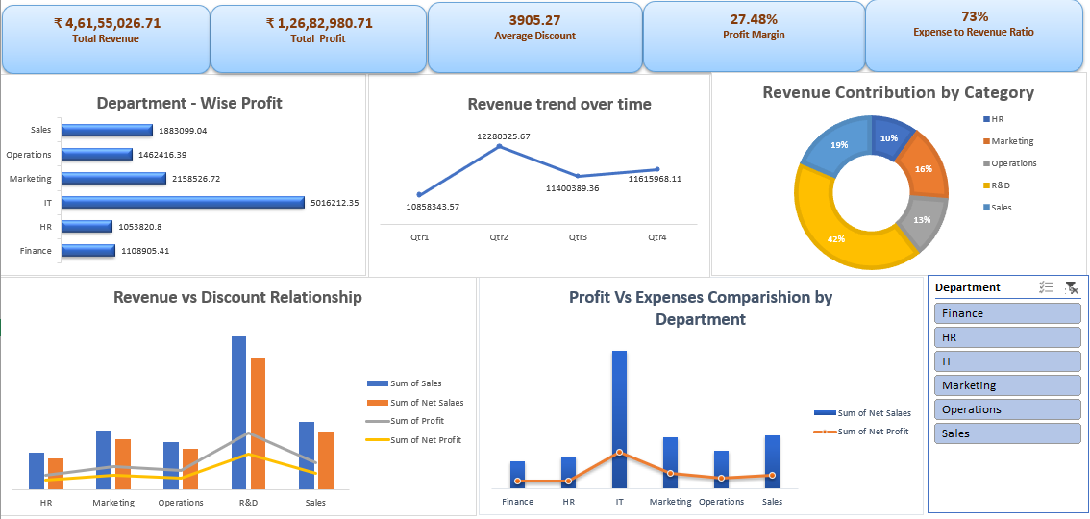
Interactive Dashboard

Slide 7
Key Insights
IT and R&D are the strongest revenue and profit contributors, showing
high operational efficiency.
HR and Finance generate the lowest performance, indicating clear
opportunities for cost optimization.
The company maintains a healthy 27.48% profit margin, but the 73%
expense ratio suggests scope to reduce costs.
Revenue peaks in Q2, showing strong seasonal demand compared to
weaker Q3 performance.
Higher discounts are reducing revenue growth and profitability, especially in Operations and HR.

Slide 8
Overall Performance
The company shows strong financial performance with steady revenue growth and a healthy profit margin.
IT and R&D lead overall performance, contributing the highest revenue and profit.
The expense-to-revenue ratio is high, indicating scope for improved cost efficiency.
Revenue shows seasonal strength with the highest peak in Q2.
Discount practices are affecting profitability, highlighting the need for optimized discount strategies.

Slide 9
Conclusion
The company achieved strong overall performance with ₹4.61 Cr total revenue and a 27.48% profit margin, showing effective operations and financial stability.
IT and R&D emerged as the top-performing departments, driving most of the profit and revenue.
Discounts have a visible impact on profitability — excessive discounts are linked with lower revenue growth and reduced profit margins.
Departments such as HR and Finance show scope for improvement in both cost control and revenue generation.

Slide 10
Recommendations
Optimize Discount Policies – Reduce unnecessary discounting and focus on value-based pricing to improve profit margins.
Cost Efficiency Programs – Analyze expense distribution across departments and identify opportunities to minimize operational costs.
Enhance Marketing ROI – Reassess marketing expenditures to ensure higher returns and align campaigns with profitable segments.
Invest in High-performing Areas – Allocate more resources to R&D and IT, as they show consistent profitability and strong revenue growth.
Quarterly Performance Tracking – Continue monitoring trends via dashboards to identify seasonal fluctuations early and make timely business decisions.

